Slide 1
Interactive Poster Paper Preview
Title of Paper
Author 1, Author 2, Author 3, etc.
Author 1 affiliation, Author 2 affiliation, etc.
Introduction
Use this slide to present the problem the paper addresses. Feel free to insert an image or graphic; make this slide your “own”.
You may customize all areas of the slides; we suggest leaving the the title, author(s), affiliation(s), and logos on this slide.
Discuss your work in more detail using the next slides.
Archiving red is # a71e39

Slide 2
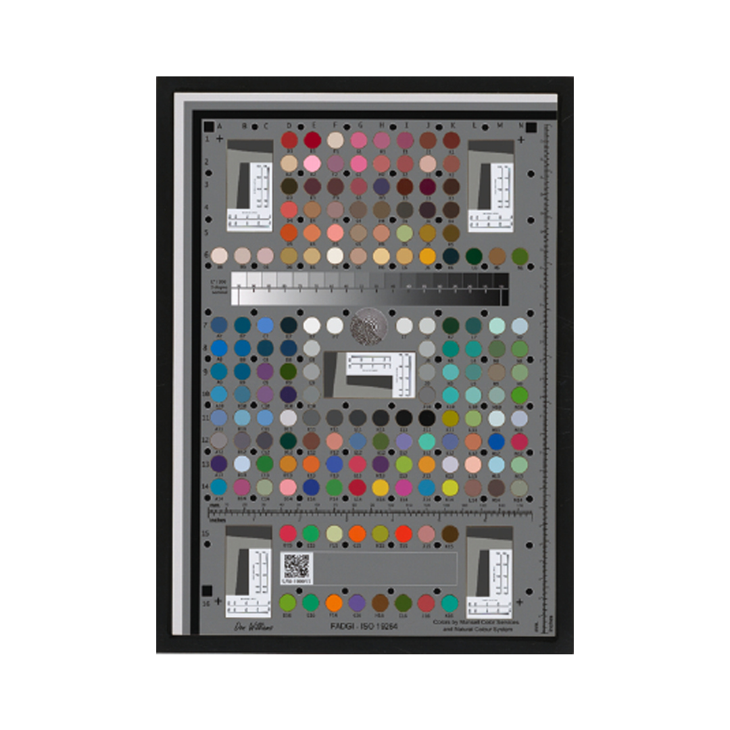
Title of Paper First author and affiliation, et al.
Experimentation/Process
Use this slide to highlight your approach to solving the problem addressed
Change the headings.
Use whatever fonts, colors, sizes, etc. you want.
Use an image(s) that draw viewers attention and provide visual context for your work.
The goal of the preview slides is to get people interested in coming to speak to you more about your work.
Images help visually to tell your story.

Slide 3
Title of Paper First author and affiliation, et al.
Conclusion/Results
You told them what and how, now review your results.
Simple slides will help you formulate a clear message. Stay focused on the main point.
You have 2-minutes for your preview. Hone and practice what you will say.

